Slide 1
System and Acceptance Testing

Slide 2
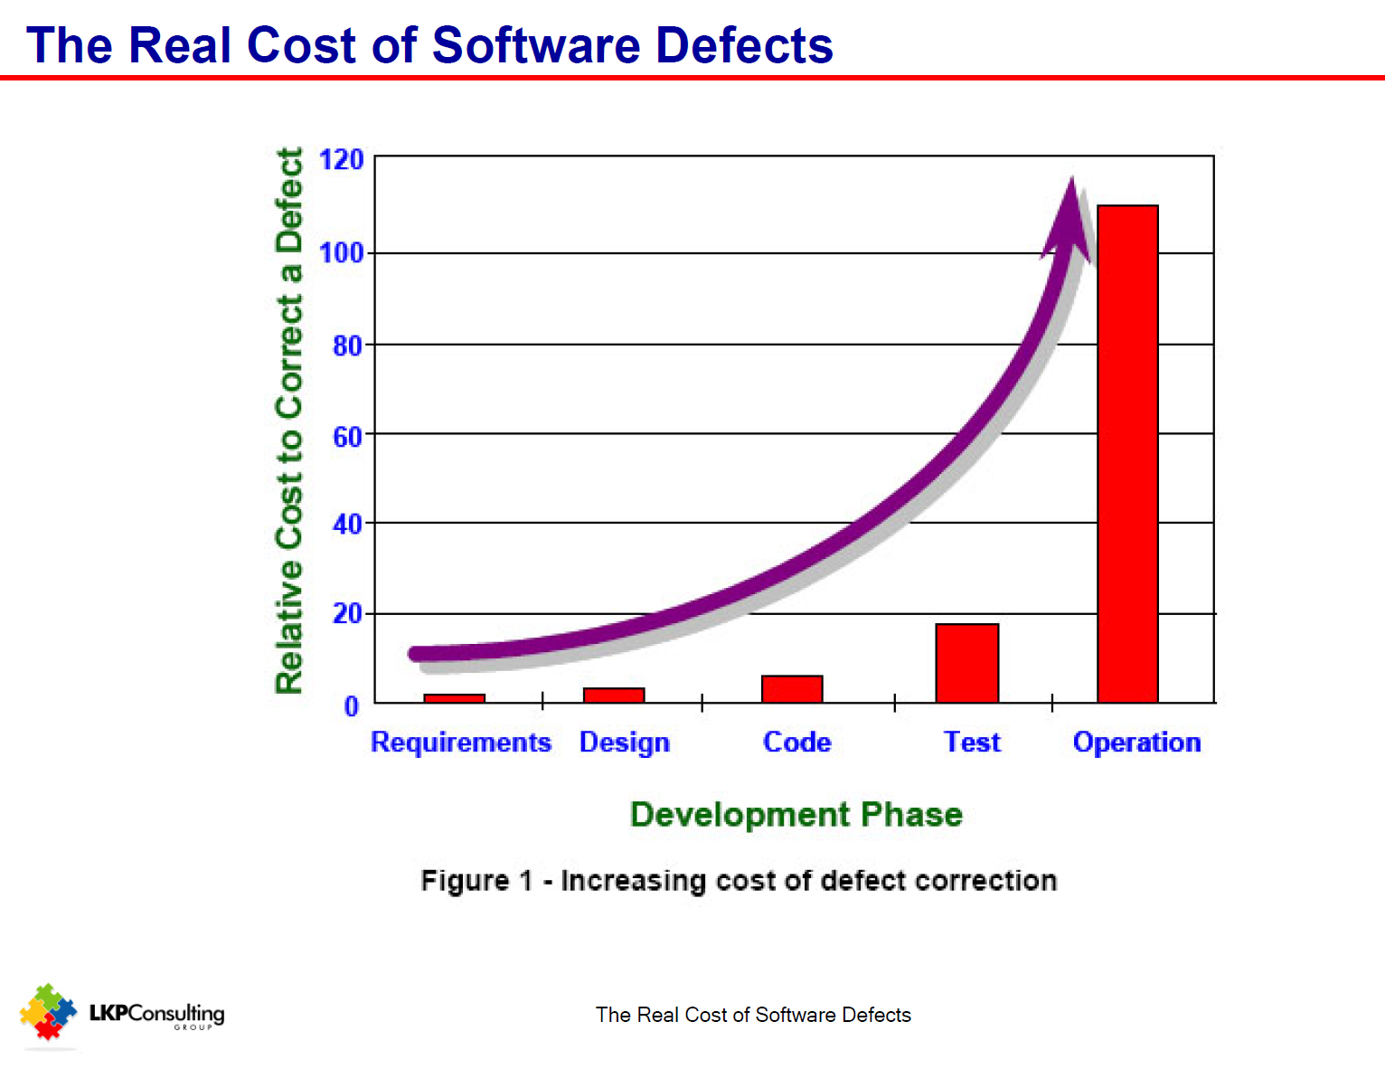
Last Week
Static Testing
ONLY way of testing requirement, analysis and design artefacts
MOST effective test method
Most COST EFFECTIVE test method
Correlated with formality of method
Other benefits
knowledge sharing
Wrinkles
Quality criteria vary with artefact tested
Tests are VERIFICATION tests

Slide 3
Verification and Validation
Important aspect of requirement quality is testability
So
Writing a test
is a verification procedure for requirements quality
Test specification should occur at the same time as requirement definition
Type of test specified:
User Acceptance Tests (UAT)
Not focused on whether meets specification but on whether software meets users needs/requirements
UAT are Validation tests, not verification tests
System level verification – System testing

Slide 4
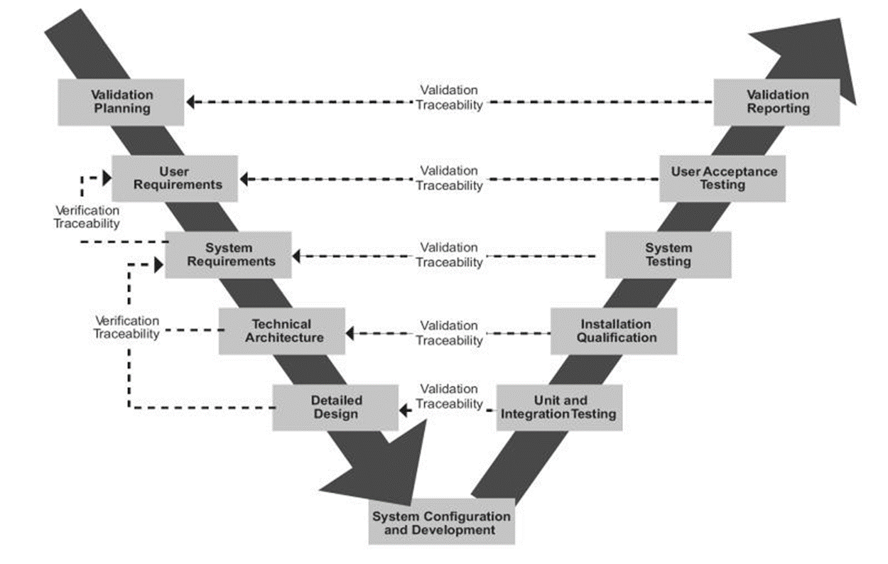
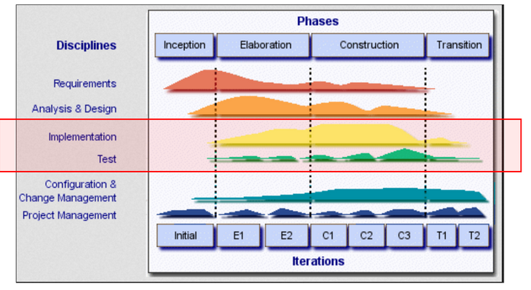
Beta UAT
User Acceptance Tests – where in the SDLC
Specified
Static Reviews
Specified first – executed last (waterfall)
Iterative incremental SDLCs – pull UAT into development process – Alpha UAT

Slide 5
Types of User Acceptance Tests
Alpha – in house, ‘involved user’, focus on defect detection
Beta – 3rd party, ‘non-involved’ user, focus on usability and capability demonstration
‘implicit’ requirements, ‘fit for purpose’
Resolve ambiguity in requirements
Contract acceptance – focus on meeting contractual obligations
Compliance – focus on meeting regulatory requirements
Health, finance, military
Operational – focus on production readiness
Operator training, backup procedures, load testing, recoverability
Black Box – focus on functional capability, defect detection

Slide 6
What gets Tested in Alpha UAT
Test cases based on use case scenarios
Step by step check of use case flows
Specification based check of system operations
Conducted in house
Focus on defect detection
Coverage (flows, conditions) is important.

Slide 7
What gets Tested in Beta UAT
Not new test cases – test cases based on previous tests (Alpha UAT)
Don’t want surprises in Beta UAT
End to end functionality
Domain based tasks
Based on business scenarios
Post modification tests
Basic sanity – ie nothing been broken
New functionality
Some non-functional quality criteria
Legal and Service Level Agreements
Maintenance readiness

Slide 8
System Testing
Not UAT – aspect of highest level integration testing
Other aspect is ‘function testing’ or ‘Alpha Stage UAT’
In house, focus on defect discovery
Focus on Non-functional Requirements
Performance, Reliability, Recoverability, Security
Checks meeting specifications - ie verification testing

